Slide 1

ECEN 3593-001 Computer Organization
Lecture #21
8 March 2021

Slide 2


Agenda
Class Announcements
Finish Chapter 4
Chapter 1

Slide 3
Class Announcements
Reading Assignment
“Computer Organization and Design, The Hardware / Software Interface, RISC-V edition,” by David Patterson and John Hennessy
ISBN 978-0-12-812275-4
Chapter 1, “Computer Abstractions and Technology”
Sections 1.1 thru 1.11 required
Section 1.12 (optional)
pages 2-54
Homework #3 is due on Tuesday, March 9 at 10:00 PM

Slide 4
Class Announcements
Phase 6 is in the deduction period – 4%/day
Phase 7 is posted – Target Date Sunday, March 21 at 10:00 PM
Bonus 1%/day (maximum 7%)
Deduction 4%/day

Slide 5
Mid-Term
Mid-Term will be held in class on Wednesday, March 17
Mid-Term practice exam will be posted by Thursday
“Computer Organization and Design” text book, and RISC-V ISA specifications will be required for reference for figures as well as to create and decode RISC-V machine code
The Mid-Term will be taken through a Canvas quiz
50 minutes
1 attempt
Open Book, but not Open People, and not google

Slide 6
Mid-Term
Mid-Term compensation
4 questions similar to questions in homework #1 thru #3
Quiz bank of 12-18 questions
(estimating 30 minutes)
~50% of Mid-Term
15 multiple choice / matching questions
Quiz bank of 30-45 questions
Definitions / Theory based questions to test comprehension of the course material
(estimating 15 minutes)
~50% of Mid-Term
Suggestion: If you are stuck on a problem, make note of it and move on to complete other questions. Then go back and work on the problems that you passed over the first time
Do not lose the opportunity to complete questions that you know

Slide 7
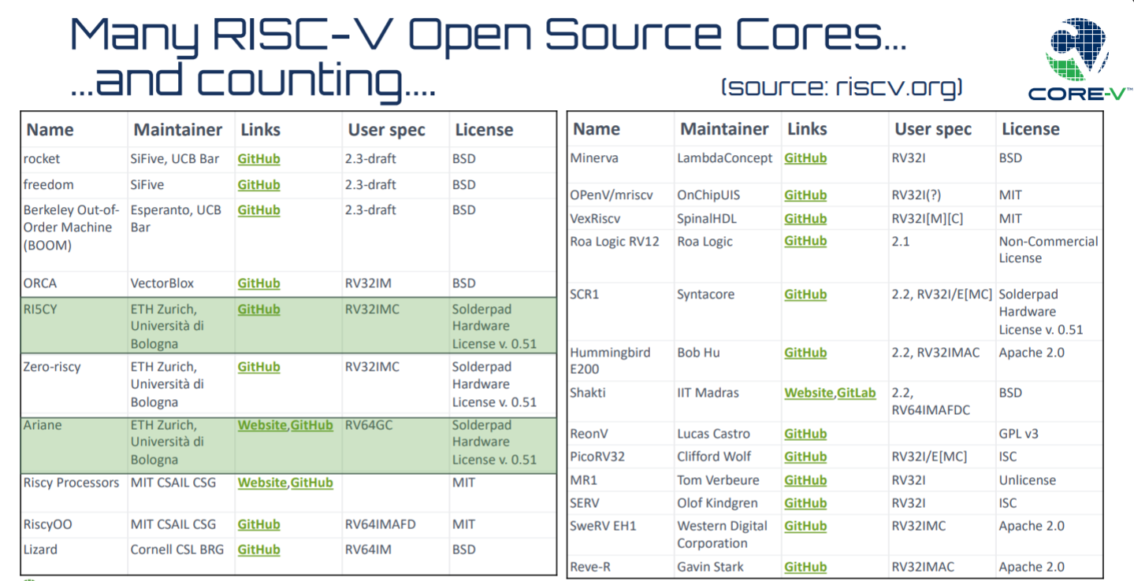
RISC-V Cores are Proliferating

Slide 8
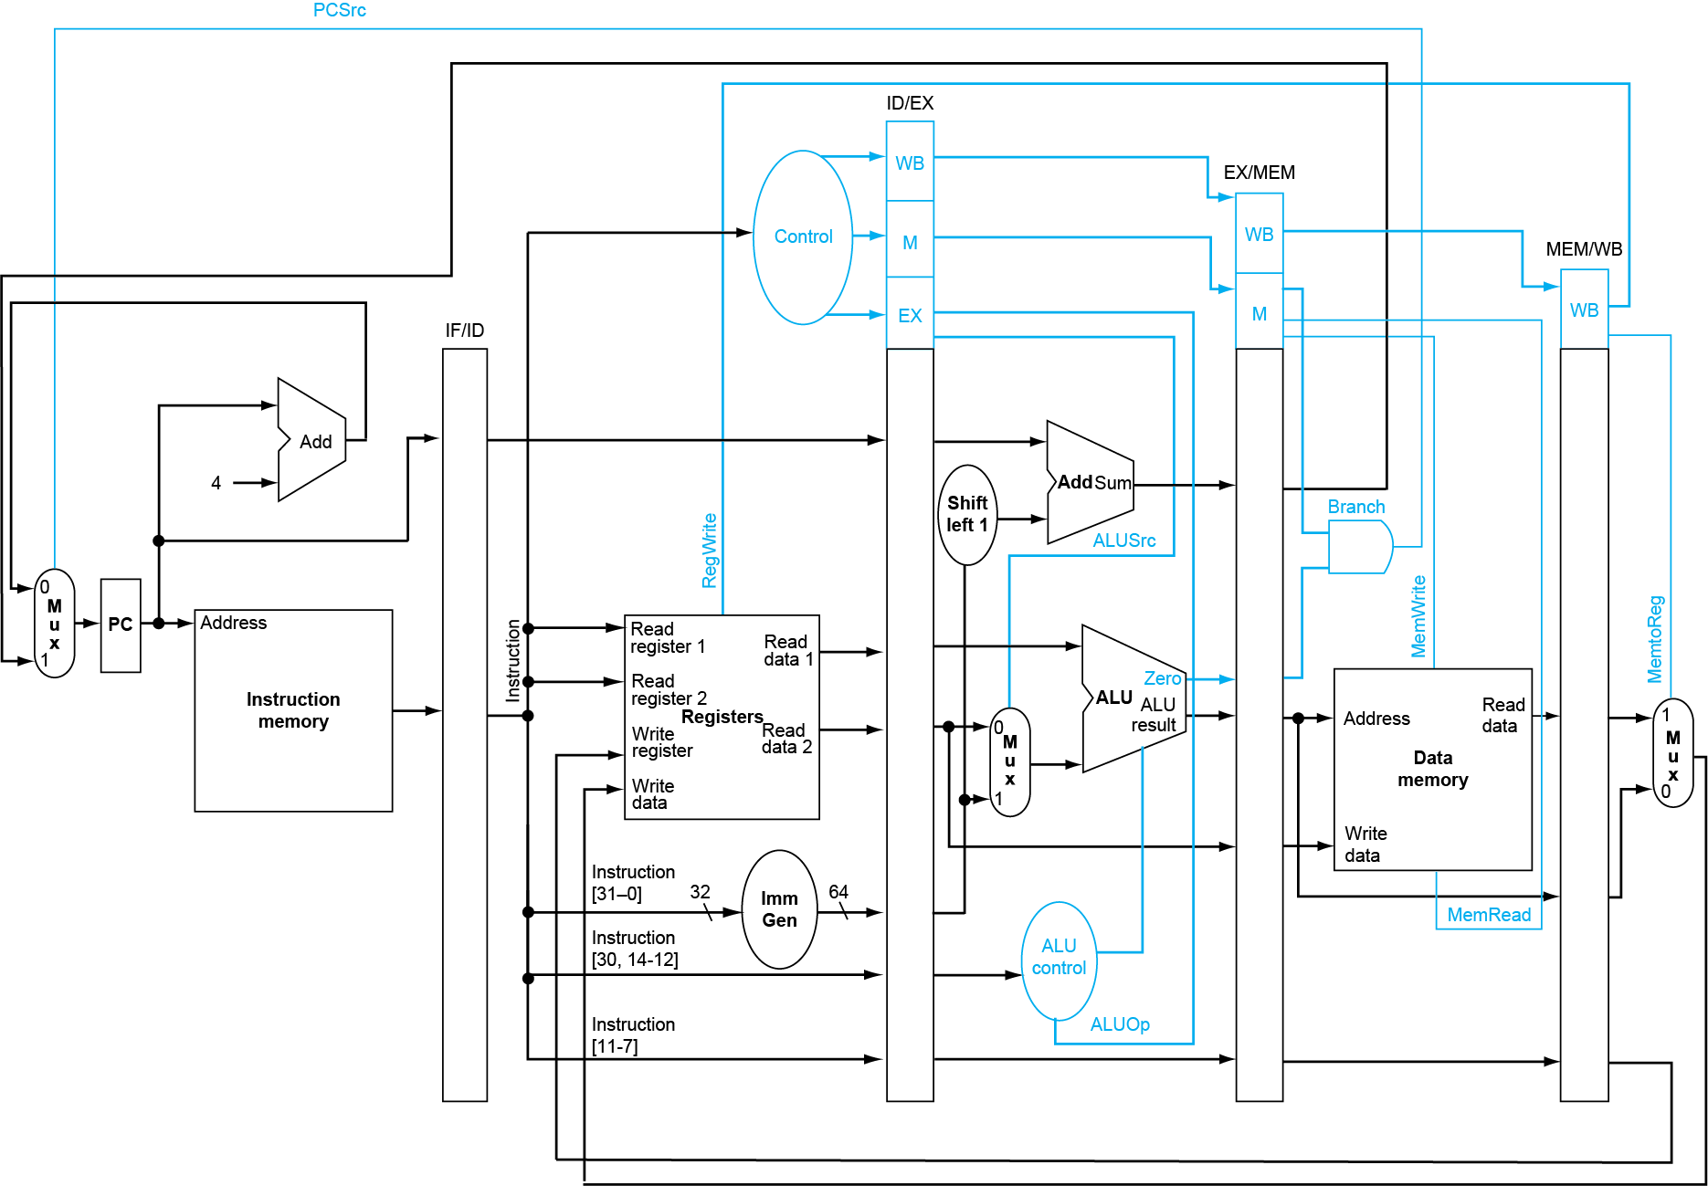
Current Branch implementation
Create condition
Create the target address
Determine whether to branch
Select the branch target address

Slide 9
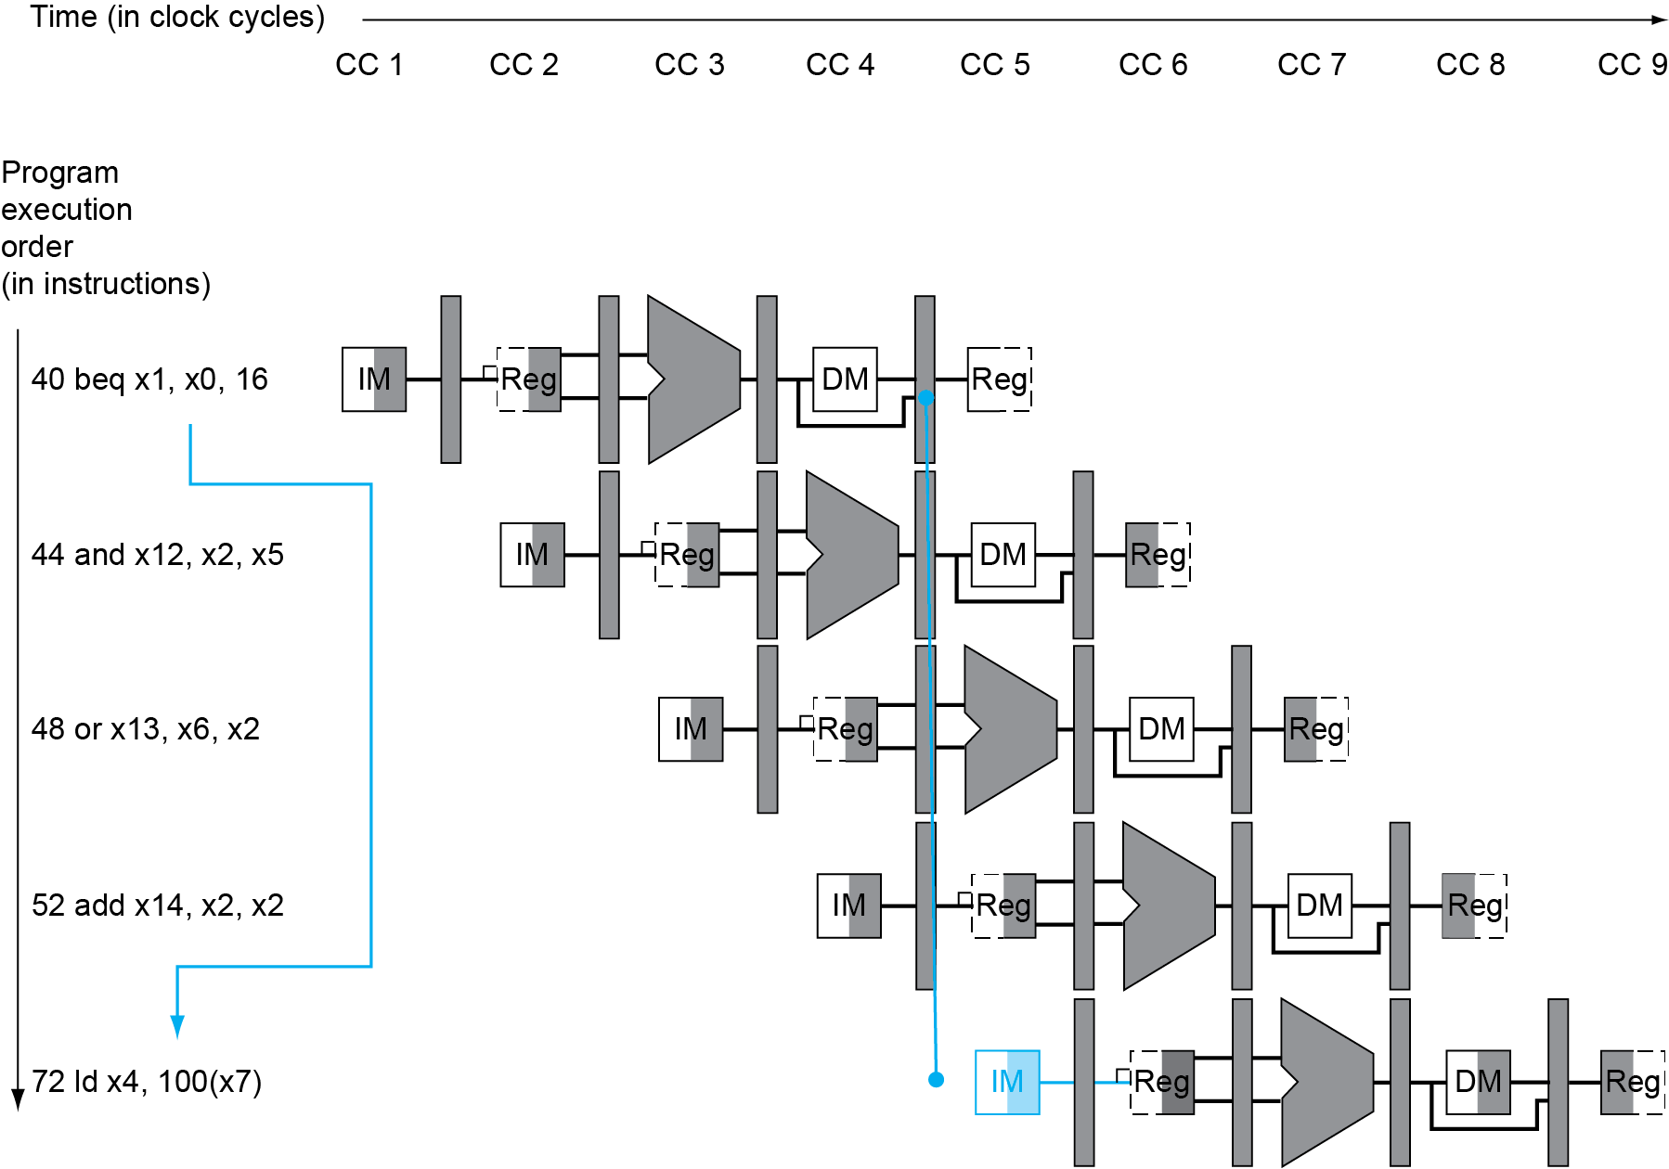
Branch Hazards - If branch outcome determined in MEM
The hazard that is the result of determining the proper instruction to fetch is called a control or branch hazard
The zero bit is available to enable the “AND” gate (branch function) to PC branch multiplexor
32
Flush these instructions
(Set s_STG_clear values to 1)
PC

Slide 10
Can We Accelerate Jumps?
Why could this be faster than a conditional branch?
Can assert the PC mux control in the ID stage (why?)
We don’t need to wait for the condition out of the ALU
We have the PC and the jump offset in the ID stage (why?)
Jump Target Address needs only the PC and the immediate
How many instructions need to be flushed in this case?
1, because we still need an extra cycle to compute the target address

Slide 11
Accelerating JAL
Move adder to ID
Don’t pipeline result
Decode PCSrc directly from the instruction
Why doesn’t this work for JALR?
Need the ALU output as the branch address

Slide 12
Dynamic Branch Prediction
In deeper and superscalar pipelines, branch penalty is more significant
Use dynamic prediction – prediction of branches at runtime using runtime information
Branch prediction buffer (aka branch history table)
Indexed by recent branch instruction addresses
Stores outcome (taken/not taken)
To execute a branch
Check table, expect the same outcome
Start fetching from fall-through or target
If wrong, flush pipeline and flip prediction

Slide 13
Dynamic Branch Prediction Buffer
Branch Prediction Buffer or Branch History Buffer is a small memory that is indexed by the lower portion of the address of the branch instruction and contains one or more bits indicating whether the branch was recently taken
An example of a 256 entry branch prediction buffer
If incorrect prediction, the CPU must flush the incorrect instruction fetched
Bits indicating branch taken or not
If “taken,” use branch target address, if not taken, use PC+4
Branch PC address lower 8 bits [9:2] ->
Branch previously taken

Slide 14
1-Bit Predictor: Shortcoming
Inner loop branches miss predicted twice
Miss predict as taken on last iteration of inner loop
Then miss predict as not taken on first iteration of inner loop next time around
outer: … … inner: …
…
beq …, …, inner … beq …, …, outer

Slide 15
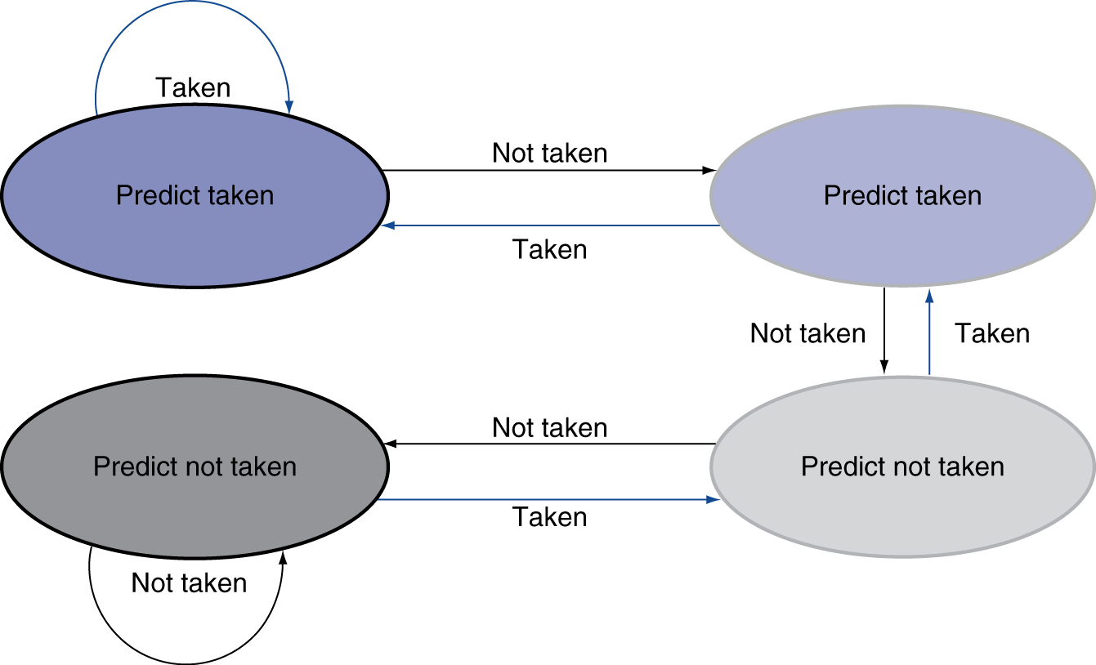
2-bit Branch predictors
Only change prediction on two successive mispredictions

Slide 16
Calculating the Branch target address
Even with predictor, still need to calculate the target address
1-cycle penalty for a taken branch
Branch target buffer
Cache of target addresses
Indexed by PC when instruction fetched
If hit and instruction is branch predicted taken, can fetch target immediately

Slide 17
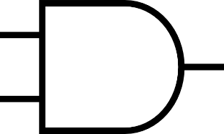
Branch Target Buffer
An example of a 256 entry branch prediction buffer
Branch Prediction Buffer a structure that caches the destination instruction for a branch
Need a “Tag” memory to hold upper address
Bits indicating branch taken or not
Previous stored upper 22-bits of last branch taken at this address
Branch target address
Branch PC address lower 8 bits ->
If “taken,” use branch target address, if not taken, use PC+4
Branch PC address upper 22 bits
22-bit comparator
Branch previously taken
1 = Entry is in Branch Prediction Buffer

Slide 18
Chapter 4 Summary
RISC-V is architected specifically to optimize a pipelined design
The hardware architecture is heavily influenced by the ISA

Slide 19
What is Performance?
Computer designers goals
Minimize execution time
Minimize development cost and sale price
How to minimize execution time?
Improve the technology of the components
Minimize clock cycles per instruction
Improve instruction efficiency
$\frac{Seconds}{Clock Cycle} X \frac{Clock Cycles}{Instruction}$ $X \frac{Instructions}{Function}$= $\frac{Seconds}{Function}$
$$\frac{Seconds}{Clock Cycle}$$
$$\frac{Clock Cycles}{Instruction}$$
$$\frac{Instructions}{Function}$$

Slide 20
Fundamental Performance Rule
The ONLY VALID MEASURE of performance is EXECUTION TIME

Slide 21
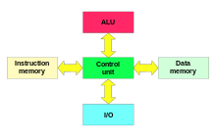
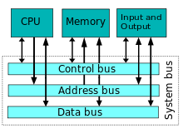
Definitions
Performance via Parallelism
Harvard architectures
Processors that have separate instruction and data caches, but more importantly, separate instruction and data busses
What advantage does this provide?
Parallel access to instructions and data
Von Neumann architectures
Instruction and data memories share a bus
Resource conflict, the memory bus
Limits performance
Fewer interconnections required
https://en.wikipedia.org/wiki/Harvard_architecture
Minimizes $\frac{Clock Cycles}{Instructions}$
https://en.wikipedia.org/wiki/Von_Neumann_architecture

